Slide 1

Six Sigma Project
Employee Attrition
Reduction Project
Red Apple Technologies (RAT)
2025
Target: Attrition ≤ 1%

Slide 2
Define Phase
Voice of Stakeholders
Voice of Customer
Voice of Business
Voice of Employee
What clients expect from RAT
Strategic objectives for RAT
What employees value most
Stable project execution without staffing gaps
Reduce attrition rate: 3.43% → 1% by Q3 2025
Career growth opportunities (L1/L2 focus)
Skilled professionals in niche technologies (VAGNETTE, INTERBASE, LITEWARE)
Control costs: Hiring ($700), Training ($1000), Productivity loss ($350)
Competitive compensation
Work-life balance (≤ 9 hrs/day)
Consistent quality & delivery timelines
Improve promotion timelines (L1→L2 in 1–1.5 years)
Healthy, stress-free environment
Minimal disruption in communication/support
Respectful management & transparent reviews
Ensure staffing for new projects
Maintain brand reputation & client satisfaction
Support for personal transitions
Key Insight
Financial Impact
Priority
Client satisfaction depends on workforce stability
$2,050 cost per attrition; $205K loss in 6 months
Growth and compensation are top concerns

Slide 3
Define Phase
CTQ Tree
Critical-to-Quality Breakdown
Retention
Keep skilled employees
Attrition ≤ 1%
Compensation
NEED
Competitive pay structure
Faster Promotions
Reduce attrition for stability & cost savings
Competitive Pay
Work Environment
Healthy workplace culture
9-Hour Workday
Current: 3.43%
Target: ≤ 1%
Skill Availability
Niche Skills
Specialized expertise

Slide 4
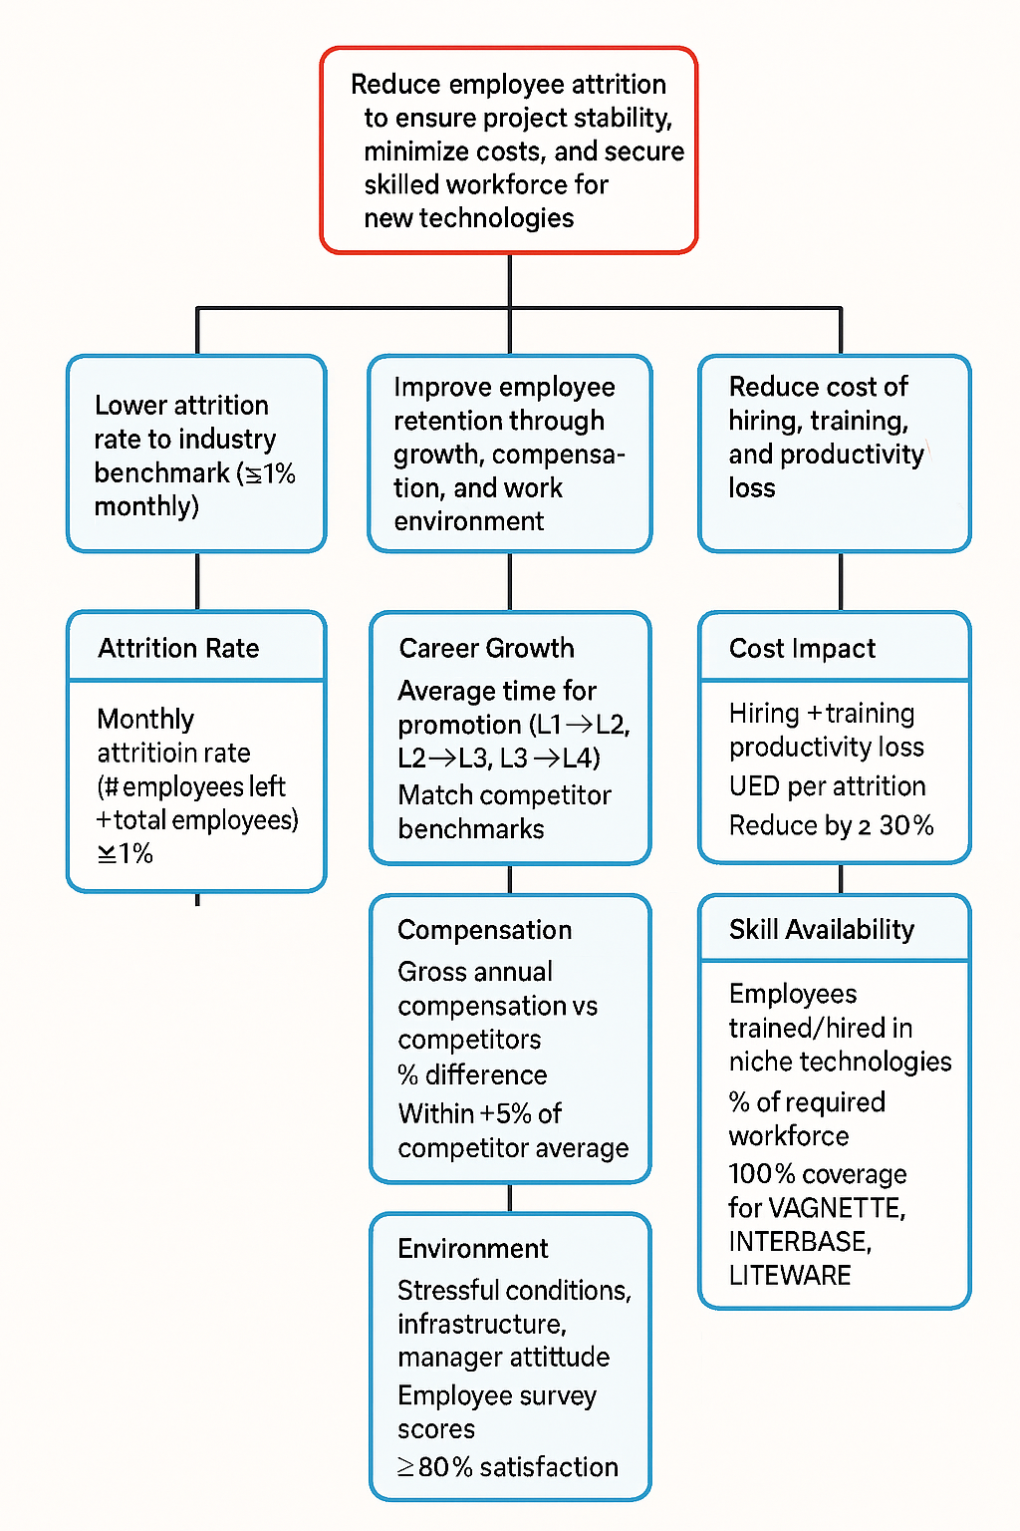
CTQ Tree
Need: Reduce attrition for stability & cost savings
Drivers: Retention, compensation, work environment, niche skills
CTQs: Attrition ≤ 1%, faster promotions, competitive pay, 9-hour workday, skill availability

Slide 5
Project Foundation
Project Charter: Attrition Reduction at RAT
Project Overview
Timeline & Scope
Project Name
Project Duration
Employee Attrition Reduction Project
Q1 2025 – Q3 2025 (9 months)
Organization
Target Completion
Red Apple Technologies (RAT)
Q3 2025
Project Type
Scope
Six Sigma DMAIC Project
All employees (L1-L4 levels)
Focus Areas
Career growth, compensation, work environment, governance
Project Goals
1
Reduce attrition rate from 3.43% to ≤ 1% by Q3 2025
Control attrition costs (~$2,050 per employee)
Key Stakeholders
2
3
Improve promotion timelines to match competitors (1-1.5 years)
Sponsor
Champion
4
Ensure workforce stability for project delivery
Senior Management
HR Head
Team Lead
Team Members
Project Manager
HR, PMs, Training

Slide 6
Project Charter
Name: |  | Pravin, Fazila, Murali, Bala |  |  |  |  |  | Batch: |  | LSS 81
Project Title |  | Employee Attrition Reduction
Company Name |  | Red Apple Technologies
Business Case |  |  |  |  |  |  | Problem / Opportunity Statement
Red Apple Technologies has experienced a surge in employee attrition, reaching 3.43% monthly, especially at L1 and L2 levels. This impacts project delivery, increases hiring and training costs, and threatens execution of new contracts requiring niche technology skills (VAGNETTE, INTERBASE, LITEWARE). The company aims to reduce attrition to 1% by Q3 2025. |  |  |  |  |  |  | Red Apple Technologies has experienced a rising employee attrition rate of X% over the past 12 months, which is significantly higher than the industry benchmark of Y%. Attrition is most pronounced among employees with less than two years of tenure, particularly in the customer support and technical teams. This trend has led to increased recruitment costs, loss of organizational knowledge, reduced team morale, and delays in project delivery. The root causes of attrition are not clearly understood, and current retention strategies have not yielded measurable improvements. Without intervention, attrition threatens to impact productivity, client satisfaction, and long-term organizational growth.
Goal Statement |  |  |  |  |  |  | Scope
• Reduce monthly attrition rate to ≤ 1% • Improve employee retention through career growth, compensation, and work environment • Ensure full staffing for niche technology projects |  |  |  |  |  |  | In Scope: Full-time and contract employees across L1–L4; voluntary attrition causes; retention strategies; niche skill acquisition Out of Scope: Retirements, internal transfers, layoffs unrelated to performance or integrity
Key Performance Indicators (KPI)
S.No | KPI |  |  |  | Project Target Period |  |  | Unit |  | Performance
 |  |  |  |  |  |  |  |  |  | Baseline |  | Target
1 | Attrition Rate |  |  |  | By Q3 2025 |  |  | % |  | 3% |  | ≤ 1%
2 | Compensation Benchmarking |  |  |  | Bi-annual review |  |  | % difference |  | 10% gap vs competitors |  | Within ±5% of competitor average
3 | Average Work Hours |  |  |  | Monthly |  |  | Hours/day |  | 10–11 hrs/day |  | ≤ 9 hrs/day
4 | Employee Satisfaction Score |  |  |  | Quarterly |  |  | % |  | 65% |  | ≥ 80%
5 | Cost per Attrition |  |  |  | Monthly |  |  | USD |  | $2050/person (Hiring $700 + Training $1000 + Productivity loss $350) |  | Reduce by ≥ 30% ($1435/person)
6 | Skill Coverage (VAGNETTE, INTERBASE, LITEWARE) |  |  |  | Monthly |  |  | % workforce |  | 40% coverage |  | 100% coverage
Project Team |  |  |  |  | Project Plan
Project Sponser |  | Red Apple Technologies |  |  | Key Milestone |  |  |  |  | Start Date |  | End Date
Project Lead |  | Pravin |  |  | Define |  |  |  |  | 14-01-2025 |  | 28-01-2025
Team Members |  | Fazila |  |  | Measure |  |  |  |  | 29-01-2025 |  | 26-02-2025
 |  | Bala |  |  | Analyse |  |  |  |  | 27-02-2025 |  | 24-03-2025
 |  | Murali |  |  | Improve |  |  |  |  | 25-03-2025 |  | 22-04-2025
 |  |  |  |  | Control |  |  |  |  | 23-04-2025 |  | 08-05-2025
Project benefits
Type of Benefit |  |  | Basis of Benefit |  |  |  |  |  |  |  | Est. Benefit by Q3
Cost Optimisation |  |  | Control costs related to hiring ($700/person), training ($1000/person), and productivity loss ($350/person) |  |  |  |  |  |  |  | Savings $ 1,45,233(Reduce loss of $205,000 to $59,766)
Employee satisfaction |  |  | Improve promotion timelines to match competitors |  |  |  |  |  |  |  | L1→L2 in 1–1.5 years
Approval
Submitted by |  |  |  | Checked by: |  |  | Approved by |  |  |  | Date: | 27/06/2025

Slide 7
Process Mapping
SIPOC Diagram – Attrition Reduction Project
Suppliers | Inputs | Process | Outputs | Customers
HR Department | Attrition data (resignations, terminations, recruitment) | DEFINE Identify attrition problem and set goals | Monthly attrition reports | Senior Management
Employees (L1–L4) | Exit interview feedback, engagement survey results | MEASURE Collect data on attrition causes, promotion timelines, compensation gaps, work hours | Root cause analysis reports | Project Managers
Competitors | Promotion timelines, compensation benchmarks | ANALYZE Identify vital causes (growth, pay, stress, manager attitude, relocation) | Cause-and-effect matrix, Pareto charts | HR Head
Training Team | Training cost data, skill development programs | IMPROVE Implement retention strategies (career growth, compensation, work-life balance, skill training) | Reduced attrition rate, improved employee satisfaction | Clients (stable project delivery)
Recruitment Agencies | New hires, niche skill acquisition (VAGNETTE, INTERBASE, LITEWARE) | CONTROL Monitor attrition monthly, track CTQs, sustain improvements | Cost savings, skill coverage, stable workforce | Employees (better growth, compensation, environment)
Core Process Phases
Supporting Activities

Slide 8
Data Collection Plan
Component | Details
Project Goal | Reduce employee attrition by identifying controllable factors.
Metrics to Collect | Attrition rate, tenure, department, role, salary band, performance rating, training participation, manager feedback, exit interview reasons.
Data Sources | HRIS (Human Resource Information System), payroll records, performance management system, employee surveys, exit interviews.
Data Type | Quantitative (attrition %, tenure, salary, ratings) and qualitative (exit interview responses, survey comments).
Collection Method | Automated extraction from HR systems, structured surveys, standardized exit interview forms.
Frequency | Monthly for quantitative metrics; ongoing for exit interviews.
Responsible Roles | HR analysts (data extraction), managers (survey distribution), Six Sigma project team (analysis).
Validation | Cross-check HRIS with payroll, ensure survey completeness, standardize interview coding.
Tools | Excel dashboards, Power BI, Minitab for statistical analysis.

Slide 9
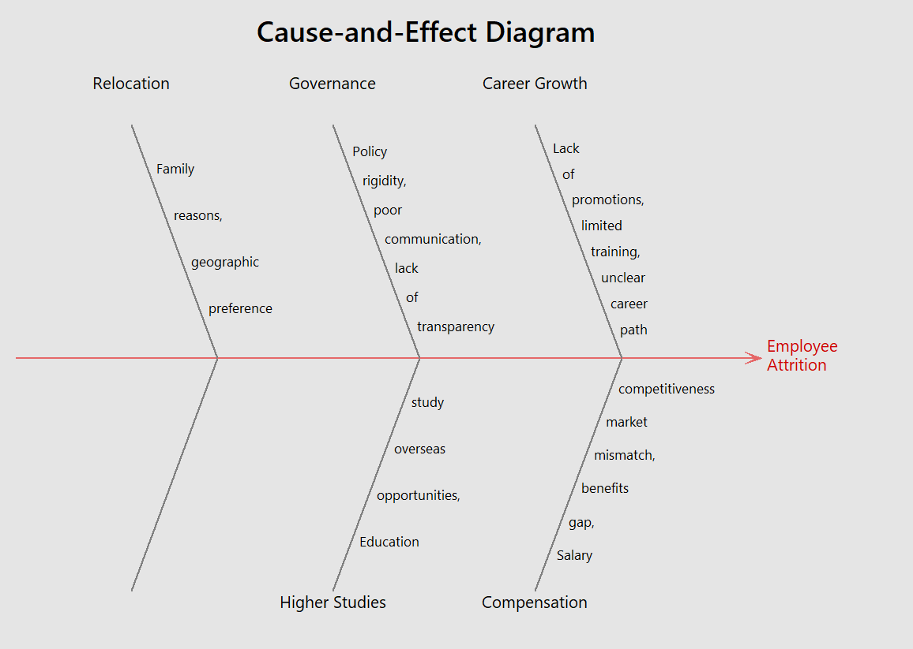
Root Cause Analysis
Fishbone Diagram
Ishikawa Analysis of Attrition Causes

Slide 10
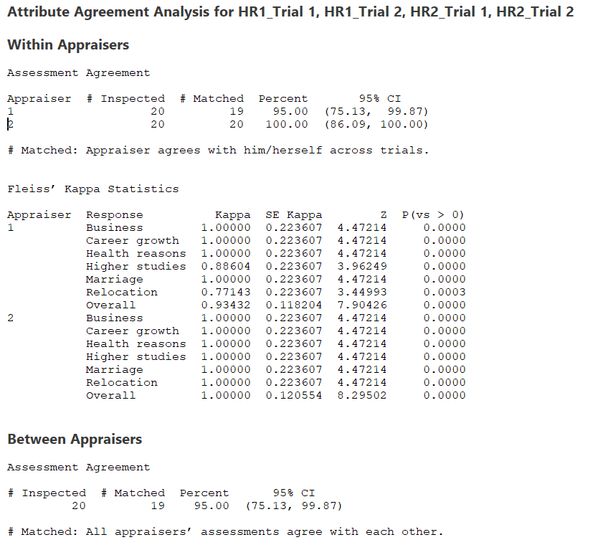
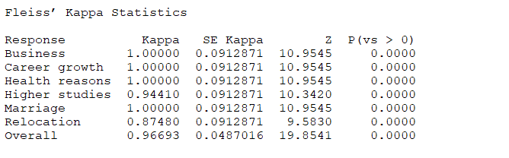
MSA

Slide 11
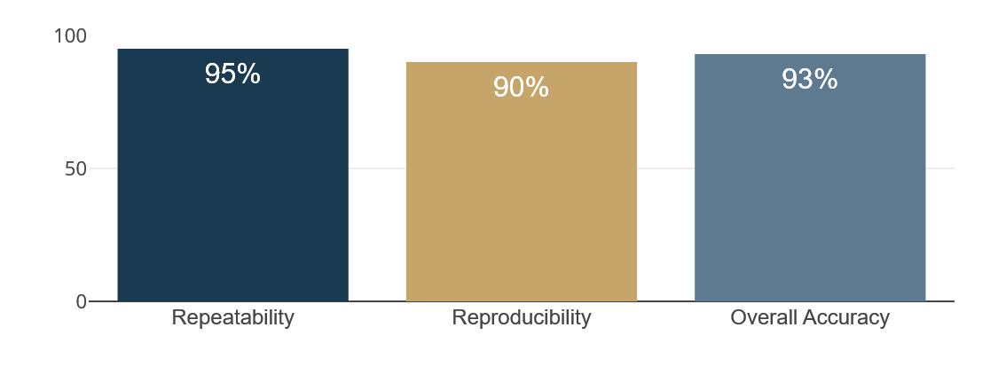
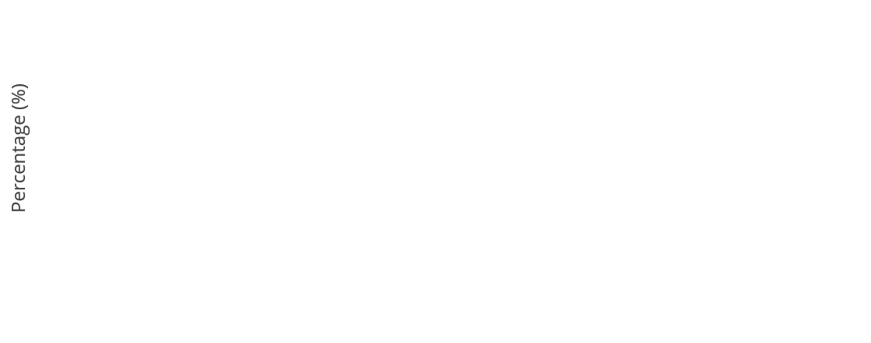

Attribute Agreement Analysis
AAA Analysis
Accuracy, Repeatability & Reproducibility
Key Metrics
AAA Metrics Overview
Repeatability
95%
Each HR appraiser gave consistent results across multiple trials
Reproducibility
90%
Different HR appraisers agreed with each other most of the time
Overall Accuracy
93%
Appraiser Agreement Matrix
Evaluations matched documented "true" reasons for attrition
Appraiser | Repeatability | vs. Standard
HR-1 | 96% | 94%
HR-2 | 94% | 92%
Average | 95% | 93%
Kappa Statistics
Kappa > 0.8 → Strong agreement beyond chance, confirming reliability of the measurement system

Slide 12
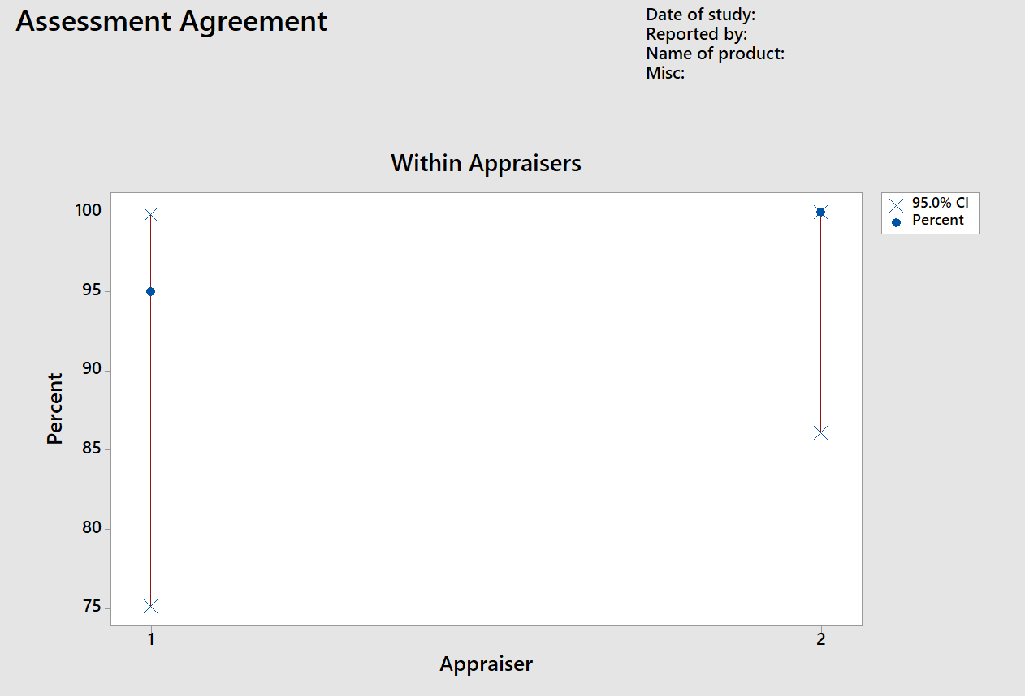
AAA Analysis
Key Findings
Repeatability (95%) → Each HR appraiser gave consistent results across multiple trials.
Reproducibility (90%) → Different HR appraisers agreed with each other most of the time.
Overall Accuracy (93%) → Their evaluations matched the documented “true” reasons for attrition.
Kappa > 0.8 → Strong agreement beyond chance, confirming reliability.

Slide 13

Statistical Process Control
Control Chart – P Chart of Attritions
Monitoring Attrition Counts Over Time
Test Results
TEST 1 FAILED
One point more than 3.00 standard deviations from center line
Failed at point:
Month 3
September spike
Chart Statistics
Center Line (CL)
4.2
Upper Control Limit
9.8
Lower Control Limit
0
Sigma Level
±3σ
Interpretation
The process shows special cause variation at Month 3 (September), indicating an assignable cause requiring investigation.

Slide 14
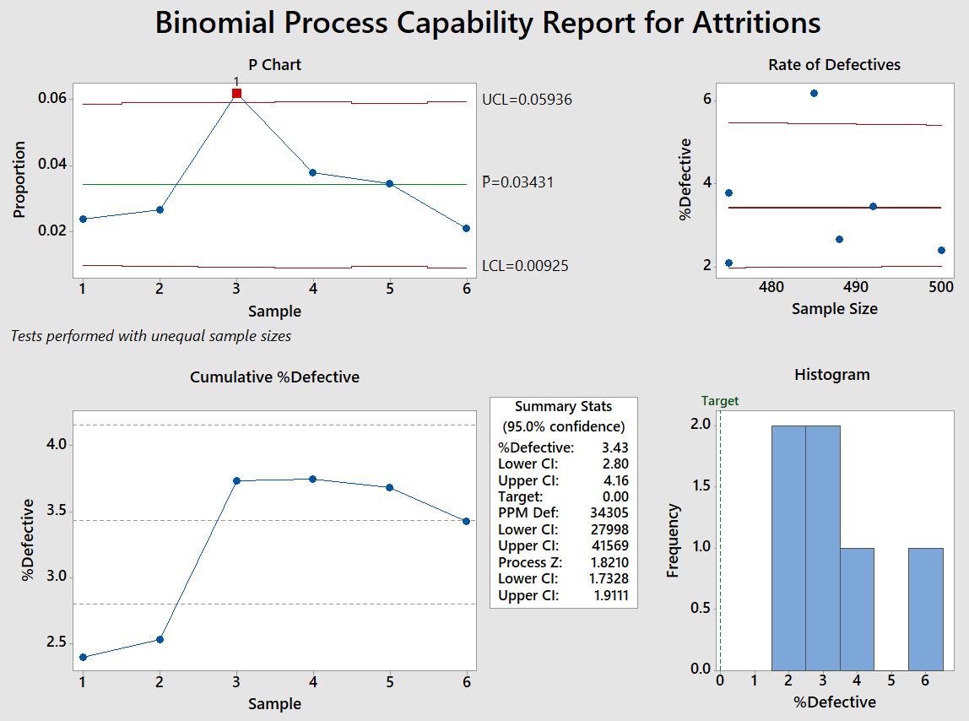


Six Sigma Metrics
DPMO Analysis
Defects Per Million Opportunities
DPMO Metrics
Defects Per Million Opportunities
34,300
Process Yield
Baseline Z Score
96.57%
1.8
Z Score with 1.5σ Shift
DPMO Scale Reference
3.3
DPMO Scale Reference
Sigma Level | DPMO | Yield
2σ (Current) | 308,538 | 69.15%
3σ | 66,807 | 93.32%
3.3σ (RAT) | 34,300 | 96.57%
4σ | 6,210 | 99.38%
5σ | 233 | 99.977%
6σ (Target) | 3.4 | 99.99966%
Sigma Level | DPMO | Yield
2σ (Current) | 308,538 | 69.15%
3σ | 66,807 | 93.32%
3.3σ (RAT) | 34,300 | 96.57%
4σ | 6,210 | 99.38%
5σ | 233 | 99.977%
6σ (Target) | 3.4 | 99.99966%
Gap Analysis
Current (Z = 1.8)
Six Sigma Target (Z = 6)
Gap: 4.2 sigma levels improvement needed

Slide 15

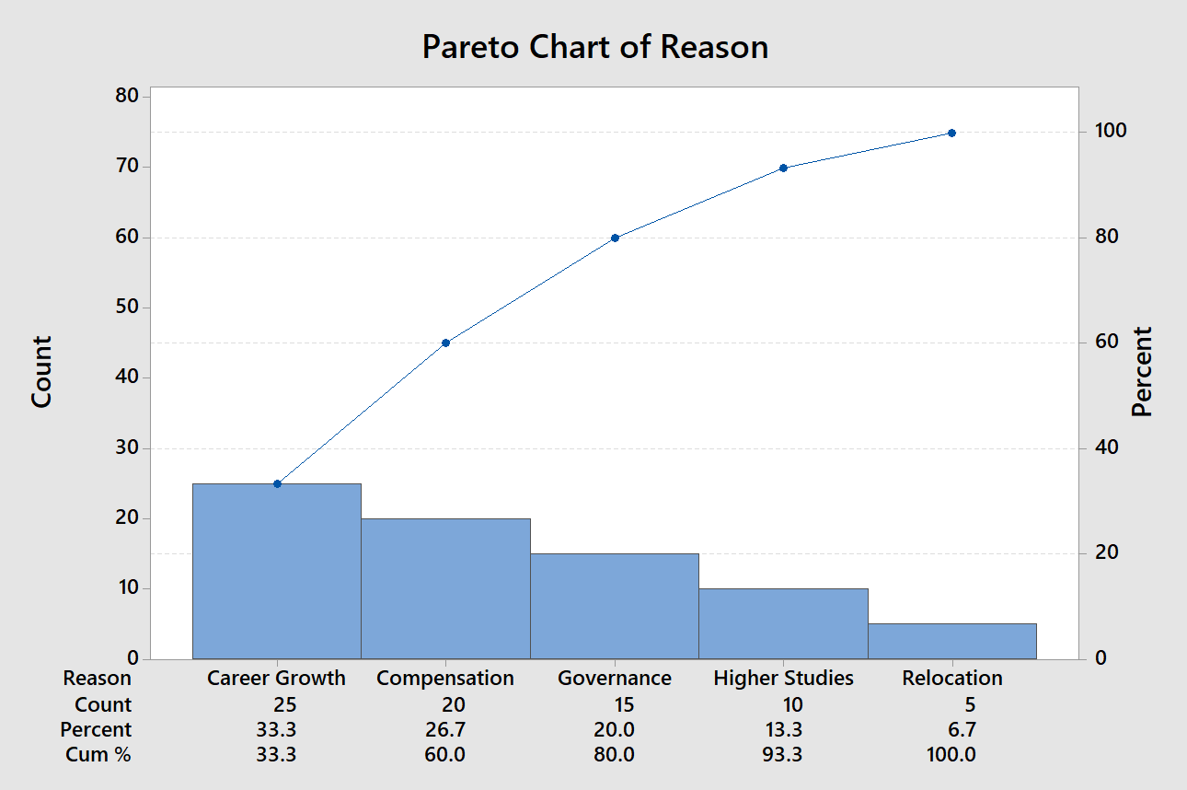
Vital Few Analysis
Pareto Chart
Key Insights
80/20 Rule Application to Attrition Causes
Vital Few (65%)
Higher Studies + Career Growth together account for 65% of attrition
Key Insights
Secondary Causes (30%)
Vital Few (65%)
Relocation and Health Reasons add another 30%
Higher Studies + Career Growth together account for 65% of attrition
Minor Contributors (5%)
Secondary Causes (30%)
Marriage and Business are minor contributors (5% each)
Relocation and Health Reasons add another 30%
Minor Contributors (5%)
Priority Action
Marriage and Business are minor contributors (5% each)
Focus improvement efforts on Career Growth and Compensation to address the vital few causes and achieve maximum impact.
Cause Breakdown
Higher Studies
35%
Career Growth
30%
Relocation
18%
Cause Breakdown
Health Reasons
12%
Higher Studies
35%
Marriage
3%
Career Growth
30%
Business
2%
Relocation
18%

Slide 16
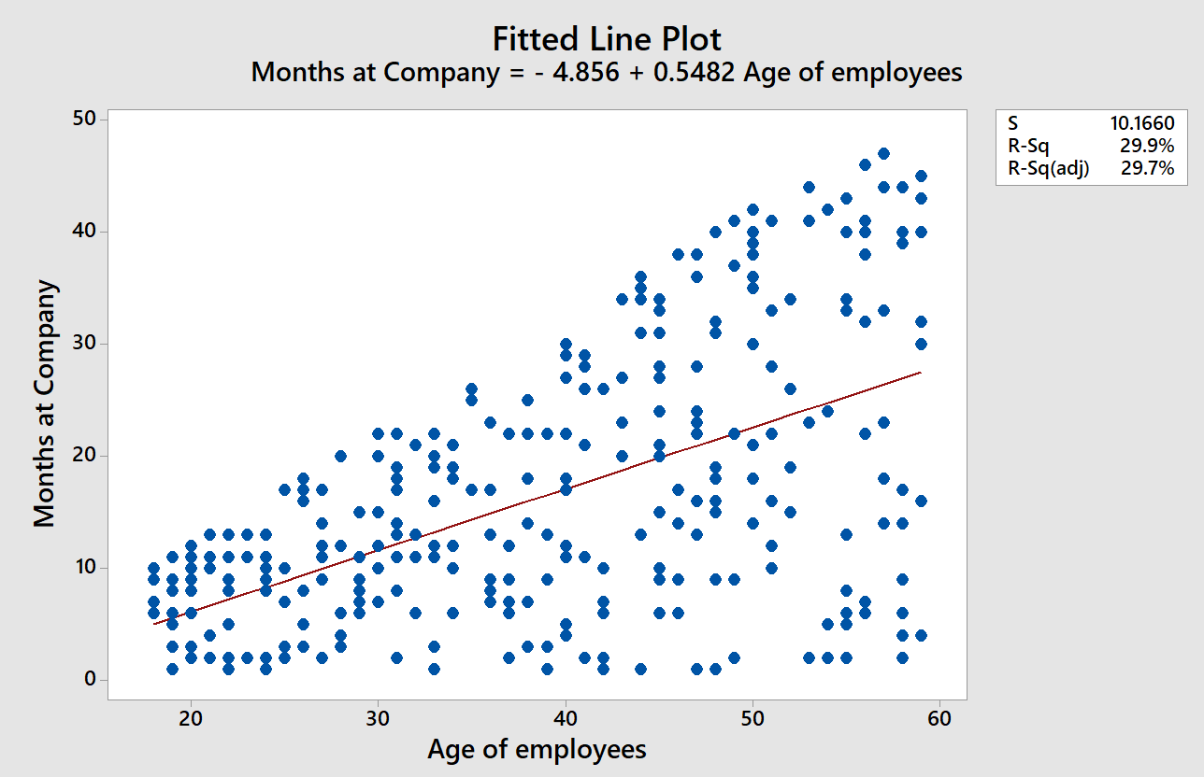


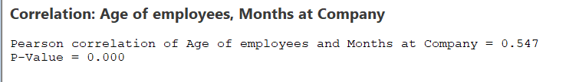
Statistical Hypothesis Testing
Hypothesis Test
Analysis of Variance for Monthly Attrition
Results
P>0.005 = H_{a}
Conclusion
Descriptive Statistics
Conclusion
Age of employees is correlated to the attrition rate due to career growth & compensation
Std Dev
Age of employees is correlated to the attrition rate due to career growth & compensation
Mean
3.43%
1.85%
Min
Max
2.11%
6.19%

Slide 17
Hypothesis 2:
Performance Hypothesis
Performance Rating | Total
Average | 172
Below Average | 45
High | 69
Low | 14
Grand Total | 300
H_{a} - Attrition is high in Average performers. This impacts career growth.

Slide 18
Root Cause Analysis
5-Why Chain for Voluntary Attrition
Why-Why Analysis – Resignations
1
Why are employees leaving?
Dissatisfaction with growth opportunities, compensation, and work environment
2
Why dissatisfaction with growth opportunities?
Promotion cycle is slower than competitors (L1→L2 takes 2 years at RAT vs. 1–1.5 years elsewhere)
3
Why slower promotions?
Limited career path planning and delayed increments (declared only in August reviews)
4
Why delayed increments cause resignations?
Employees wait for August reviews, and if dissatisfied, resign immediately after
ROOT CAUSE
Poor growth prospects and delayed promotions compared to competitors create employee dissatisfaction leading to voluntary attrition

Slide 19
5-Why Chain for Involuntary Attrition
Root Cause Analysis
Why-Why Analysis – Terminations
1
Why were employees terminated?
Integrity violations and non-performance
2
Why integrity violations?
Misuse of infrastructure (restricted sites, fake bills, stealing, etc.)
3
Why misuse occurs?
Lack of monitoring and weak enforcement of policies
4
Why weak enforcement?
HR and managers not consistently auditing employee behavior
ROOT CAUSE
Weak governance and monitoring of employee conduct allows integrity violations to go undetected until they become termination-worthy offenses

Slide 20
Comprehensive Analysis Summary
Overall Summary of Cause Analysis
Six Sigma Tools & Findings at Red Apple Technologies
Six Sigma Tools & Findings
Why-Why Analysis Summary
MSA
Resignations Root Causes
Reliable data (Kappa > 0.8, Repeatability 95%)
Slow promotions (2 yrs vs 1-1.5 yrs)
Pareto
Delayed increments (August reviews)
Higher Studies + Career Growth = 65% of attrition
Poor compensation vs market
Control Chart
Sept spike (6.19%) → special cause variation
Terminations Root Causes
Integrity violations
Cp/Cpk
Weak governance & monitoring
Cp = 0.12, Cpk = -0.58 → Process not capable
Inconsistent policy enforcement
DPMO
34,300; Yield = 96.57%; Z ≈ 1.8 (baseline)
1
Primary Root Causes
Hypothesis Test
2
Career growth dissatisfaction
Attrition significantly > 1% (p > 0.05)
Poor compensation
3
Stressful work environment

Slide 21

Project Conclusion
Control Measures & Final Recommendations
Control Measures
Final Recommendations
Standardization & SOPs
Align promotion cycle with competitors (1-1.5 years)
Documented retention procedures
Benchmark compensation regularly & adjust
Enforce work-life balance policies (9-hour day)
Attrition Dashboards
Strengthen governance & monitoring systems
Monthly np-charts & trend analysis
Continuous improvement via quarterly reviews
KPIs
Attrition %, promotion cycle, work hours
Target Achievement
Preventive Controls
Attrition ≤ 1%
Alerts, audits, benchmarking
by Q3 2025
Feedback Loops
Surveys, exit interview checks
Expected Outcomes
Workforce Stability
Cost Savings
Client Satisfaction
Next Step: Implement & Sustain Improvements

